Slide 1
Natural Remedies for Families: Support for the Cold and Flu Season By: Tara Pollock, ND

Slide 2
Flow
INTRODUCTION 3
Ways to stay healthy 4
What to do at first signs of illness 6
Homeopathy for cold and flu 8
Tummy Troubles 9
Recipes and home care 10

Slide 3
Who I am: Dr. Tara Pollock, Mom to a Little Stepper, Naturopathic Doctor and co-founder of Helios Natural Medicine: a primary care naturopathic clinic in Burlington’s South End

Slide 4
Ways to stay healthy
Lifestyle measures to keep the immune system strong

Slide 5
Ways to stay healthy:
Focus on good nutrition: eat a variety of vegetables, fruits, whole grains, beans and legumes, nuts and seeds, and healthy proteins. Add garlic, ginger, onion, turmeric, and other spices to your food.
Stay hydrated: water, herbal teas
Get plenty of sleep and don’t push yourself if you are feeling run down
Wash your hands regularly
Use essential oils

Slide 6
What to do at the first signs of illness
Boost your immune system

Slide 7
At the first sign of illness:
Take lifestyle measures to support yourselves and your little ones:
Take time to rest: extra long nap or early bedtime
Cut out dairy and sugar
Make bone broth or mineral rich vegetable soup
Anti viral herbal teas with local honey: lemon balm, elderberry, licorice, tulsi
Extra support:
Increase vitamin D for 4 days: 5000-10,000IU daily for kids and 25,000IU daily for adults
Herbal antivirals: elderberry, lemon balm, astragalus, reishi mushroom, echinacea
Tea, tincture, glycerite, capsules, chewable
Homeopathy as indicated:
See next slide

Slide 8
Homeopathy for cold and flu
Allium cepa: Runny nose with watery eyes, clear discharge
Pulsatilla: Cold with thick, yellow discharge; child is clingy and wants comfort
Aconite: Sudden onset of cold/flu with high fever
Belladonna: Fever with flushed appearance, thirstless
Gelsemium: Weak, drowsy, dizzy, heaviness with extreme fatigue
Hepar Sulph: Chesty, wet croup like cough, sensitive to cold and touch
Phytolacca: Sore throat that radiates to the ears with swallowing
Blends: Cold calm, Chestal *easy to use, well tolerated*

Slide 9
Tummy Troubles
Constipation
Peach, plum, pear, prune
Chia seeds
Extra water
Herbal tea (peppermint, ginger, fennel, chamomile)
Nausea, vomiting, diarrhea
BRAT diet: Bananas, rice, applesauce, toast
Easy to digest foods: blended soups, stews, porridge
Probiotics
Ginger or chamomile tea

Slide 10
Recipes and Home Care
Hydration
Nourishment
Hydrotherapy

Slide 11
Hydration
Herbal Popsicles
Herbal popsicles are a great way to get the anti viral and immune supportive benefits of tea in a tasty and fun treat for kids and adults alike
Chamomile Dream
2 c chamomile herbal infusion
1 c frozen blueberries
1 TBS raw honey
Brew the chamomile tea: 2 tea bags in 2 cups of boiling water. Cover the tea with a lid and steep for 10-15 minutes. Stir in raw honey, then blend with the frozen blueberries. Pour Brew the licorice tea: 2 tea bags in 1 cup of boiling water. Cover the tea with a lid and steep for 15-20 minutes. Stir in raw honey, then blend with the coconut milk. Pour into the popsicle molds and freeze.

Slide 12
Elderberry Pops 2 c lemon balm herbal infusion 1 TBS elderberry syrup 1 TBS raw honey Brew the lemon balm tea: 2 tea bags in 2 cups of boiling water. Cover the tea with a lid and steep for 10-15 minutes. Stir in elderberry syrup and raw honey. Pour into the popsicle molds and freeze. Licorice Love 1 c licorice root infusion 1 c coconut milk 1 TBS raw honey Brew the licorice tea: 2 tea bags in 1 cup of boiling water. Cover the tea with a lid and steep for 15-20 minutes. Stir in raw honey, then blend with the coconut milk. Pour into the popsicle molds and freeze.

Slide 13
Hydration continued
Garlic and/or Ginger Lemonade
Herbal tea with honey:
Make a medicinal cup by steeping the tea covered for 10-20 minutes
Choose antiviral teas like elderberry, licorice, lemon balm, tulsi
Watered down organic juice; 1 juice: 4 water
Electrolytes
Important in the case of fever

Slide 14
Nourishment
FOCUS ON
Spices: garlic, ginger, turmeric, cinnamon, sage, oregano, rosemary, thyme
Easy to digest foods: soups, stews, broths, porridges
Fasting is sometimes appropriate
MINIMIZE
Dairy when congested
Sugar

Slide 15
Hydrotherapy
Steam Inhalation
Warm up water in a pot, remove from the stove
Put 3-5 drops of essential oil (eucalyptus, rosemary, oregano, etc) or 1 TBS kitchen herbs like thyme, rosemary or oregano in the water
Put a towel over your head, close your eye, and breath in the steam
Warming sock treatment
This treatment acts to reflexively increase the circulation and decrease congestion in the upper respiratory passages, head, and throat. It has a sedating action and many patients report that they sleep much better during the treatment. This treatment is also effective for pain relief and increases systemic healing response.

Slide 16
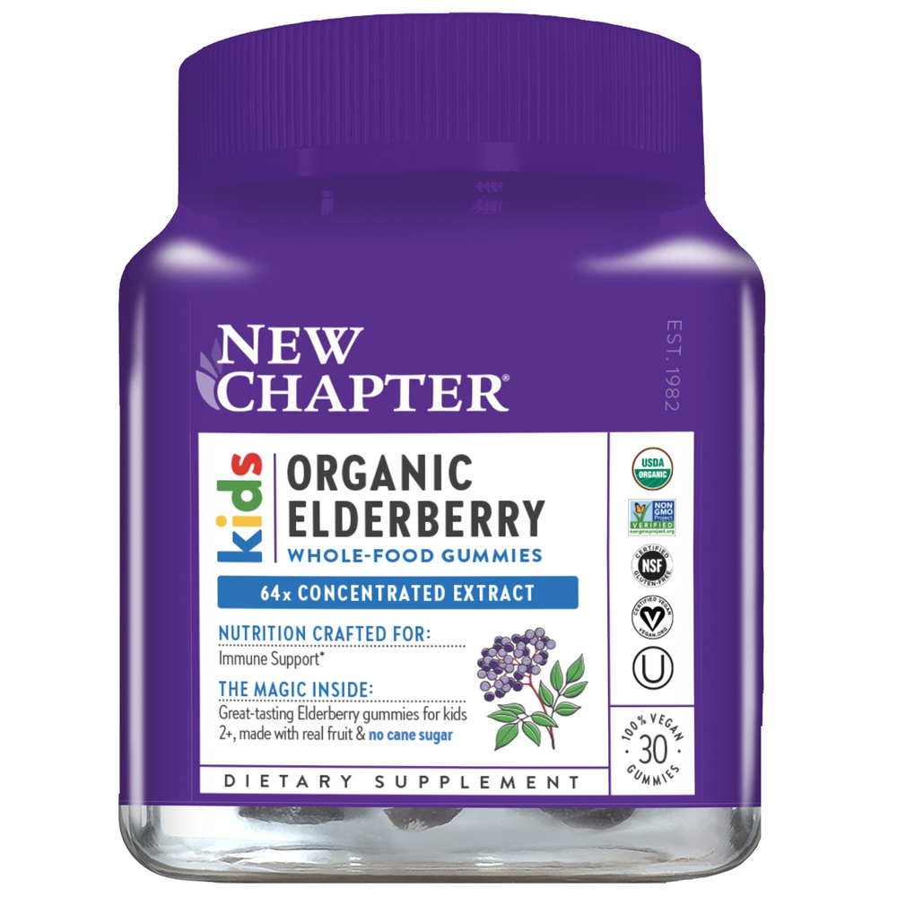
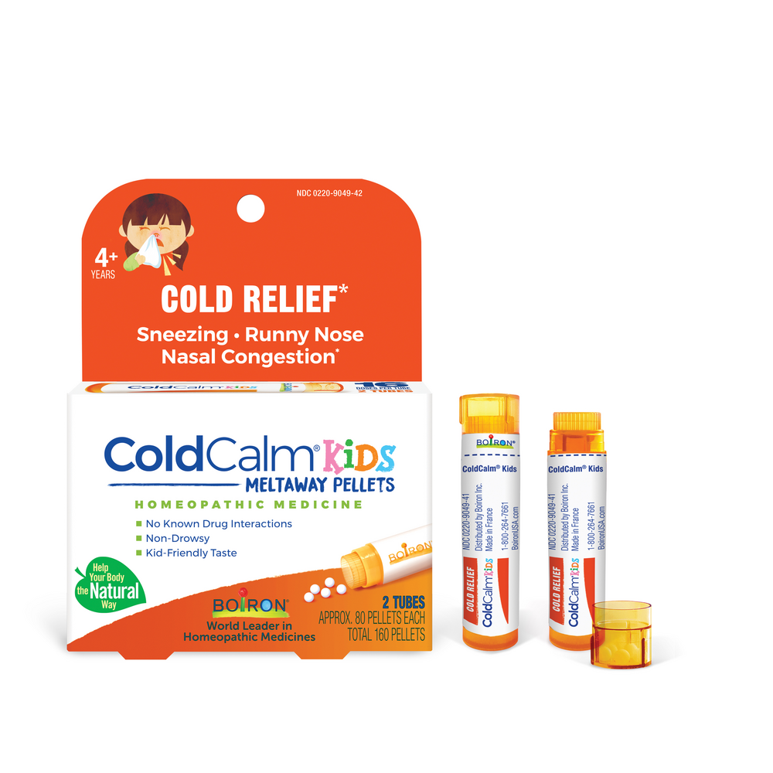
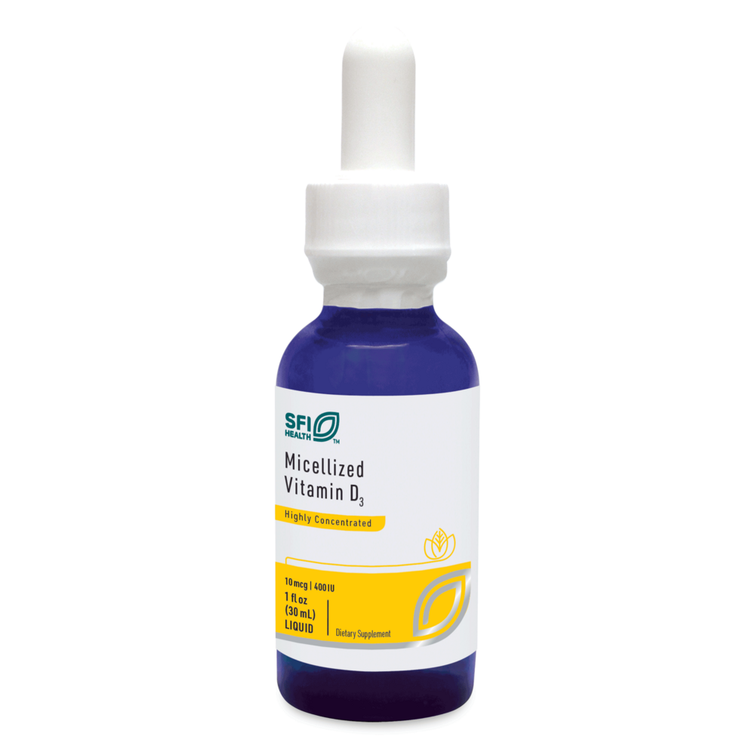
Immune Support Kit for Kids
Organic Elderberry gummies (made without sugar)
Herb Pharm Kids Immune Fortifier
Homeopathic Children’s Coldcalm
Liquid Vitamin D3
Kit cost $85
All profits donated to Stepping Stones

Slide 17
thank you!
Dr. Tara pollock
(802)540-0066
www. Heliosnaturalmed.com
To find the handouts:
Go to our website → Patient resources → Education

